Slide 1

By, Gopika.C Jayashree.M
PASSWORD CRACKING

Slide 2
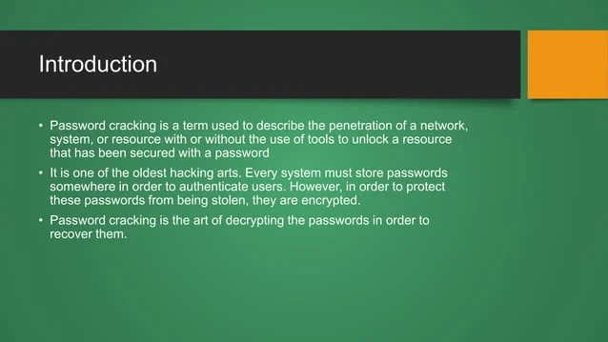

Slide 3
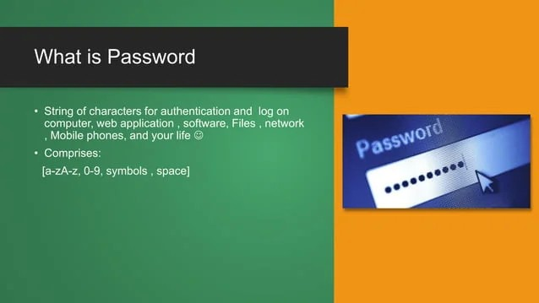

Slide 4
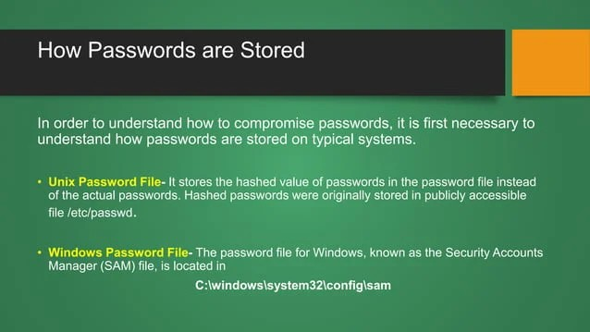

Slide 5
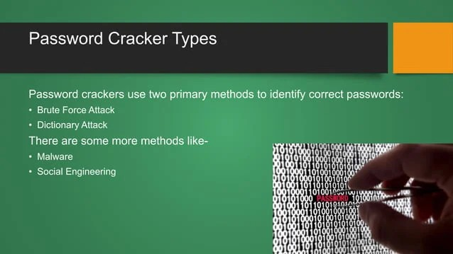
PASSWORD CRACKER TYPES

Slide 6
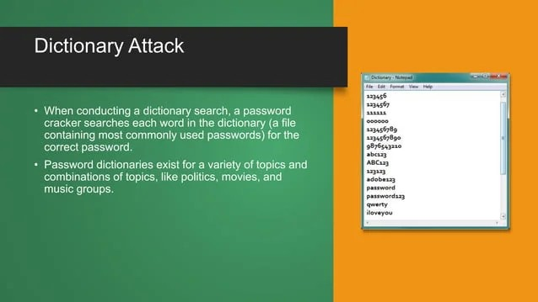
Dictionary Attack

Slide 7
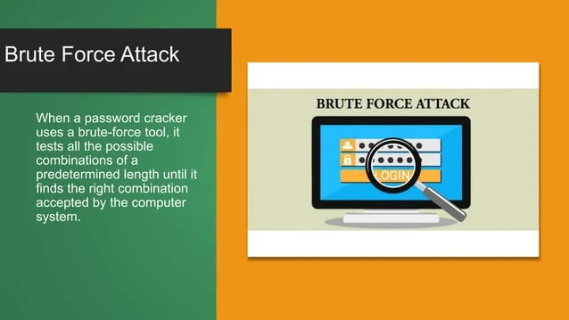
Brute Force Attack

Slide 8
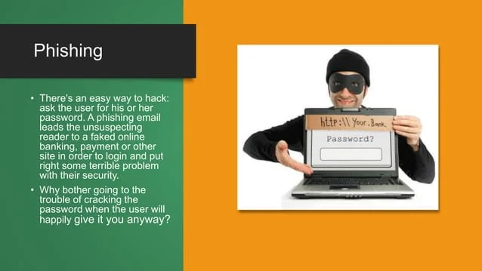
Bnm

Slide 9
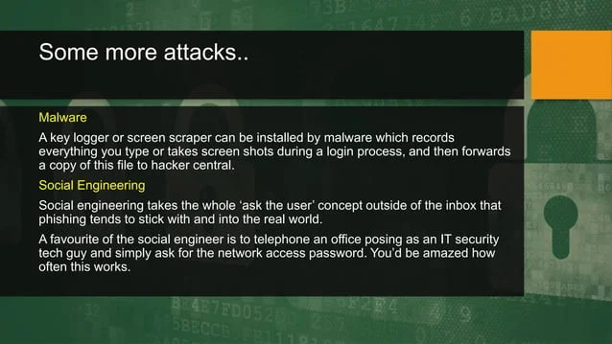
Some More Attacks

Slide 10
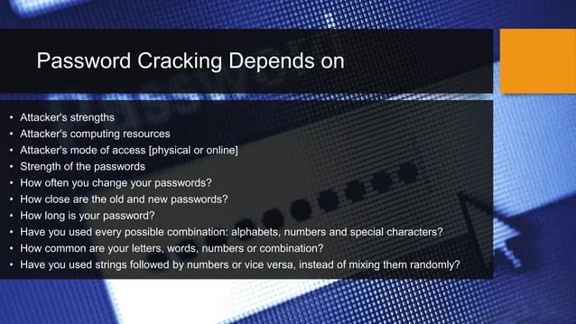
Password cracking depends on

Slide 11
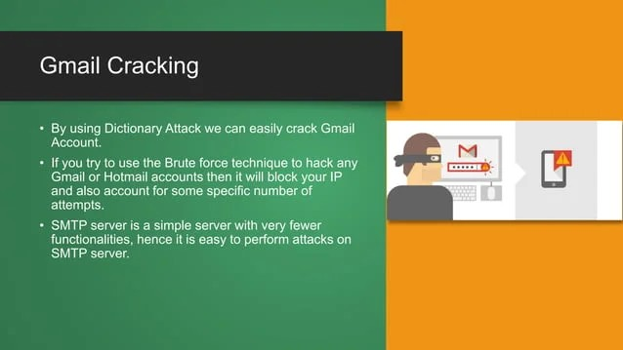
Gmail cracking

Slide 12

Conclusion

